Slide 1
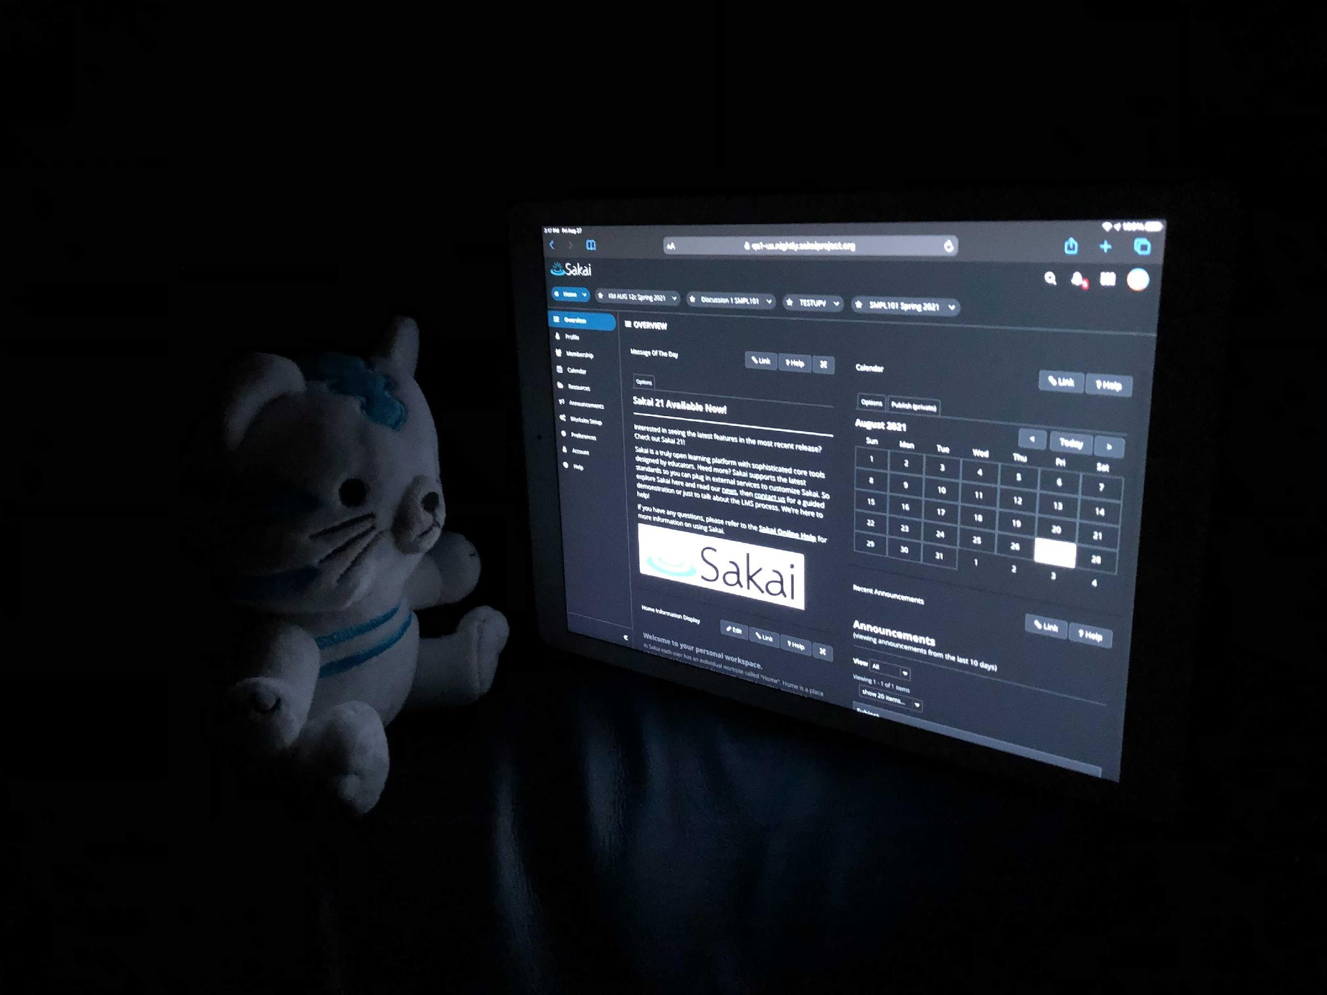
A Visit from the Sakai Sales Department (circa 2025)
Charles R. Severance
Learning Experiences
www.learnxp.com

Slide 2

Facetious !!
This is a comedy routine exploring a possible future. It is not a Sakai Roadmap – or promise in any form.
It is comedy folks – that is why the presenter is wearing a costume.

Slide 3

Thank you
Thank you for giving me some time during your Request for Information (RFI) process to explain why I think that your should consider moving from BanditLMS to SakaiLMS.

Slide 4
BanditLMS – What we hear
Positives
Negatives
Cloud hosting is great
Product is consistent - almost no changes over the years
The vendor handles upgrades and makes sure the system scales
Very simple for Campus IT
Feature requests are ignored
Subtle bugs sit forever
No way to have a conversation with the "vendor"
You data is locked in
A teacher has an idea how change the product so you can to teach better...

Slide 5

SakaiLMS – Advantages
Positives
More Positives
Cloud hosting is great
Product is consistent - almost no changes over the years
The vendor handles upgrades and makes sure the system scales
Very simple for Campus IT
You can be part of the Sakai community
File and track your own bugs
Go to core developer meeting and get a status update
Attend a monthly meeting with your cloud vendor
Self-hosting is an option

Slide 6
Advantage: Open Community
When you adopt Sakai – you have an "all access pass"
Two annual "user group" meetings
Six weekly open online meetings you can attend, developer, QA, UI/UX...
Anyone can attend and help – support staff, faculty and instructional designers are welcome
For significant new work you can be part of the design, monitoring, and optionally funding
We have an open multi-year roadmap and are excited to take your input
You can file, track, advocate for and help fix bugs you find

Slide 7
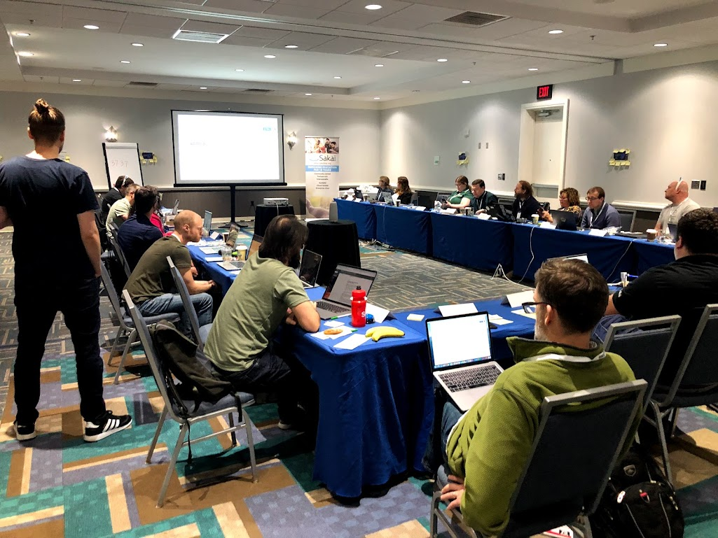
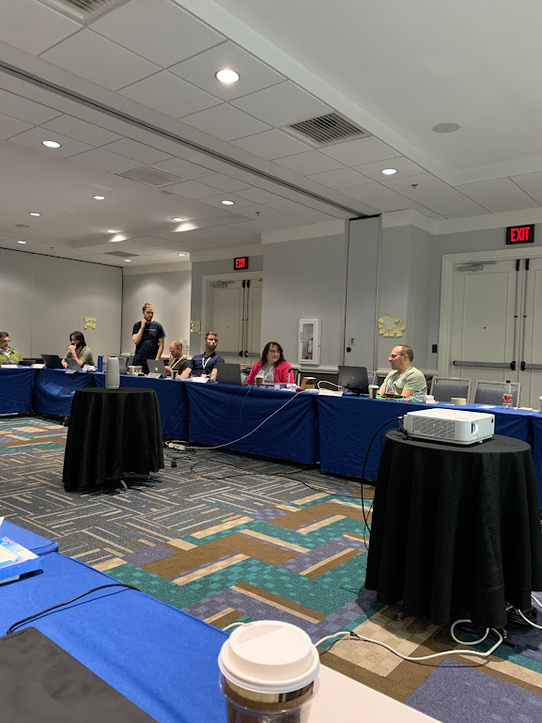
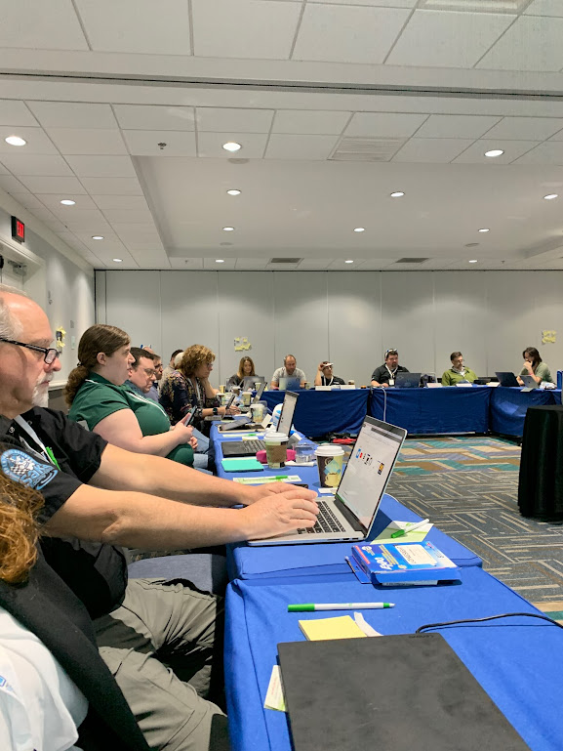
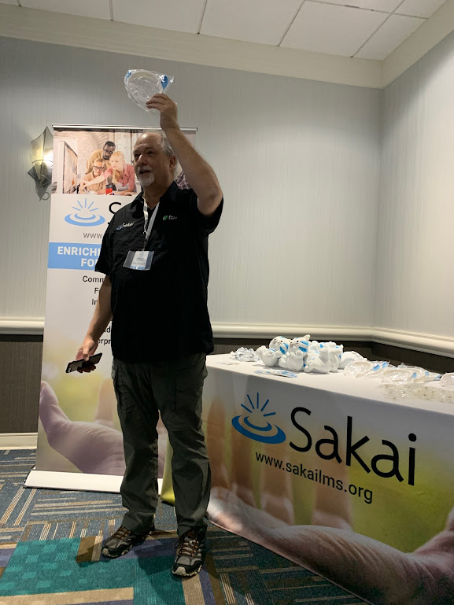
Advantage: Open Community
We have a annual team retreat – "Sakai Camp" – and you are invited and encouraged to contribute.
You are in the same room as the core leadership for every aspect of Sakai

Slide 8
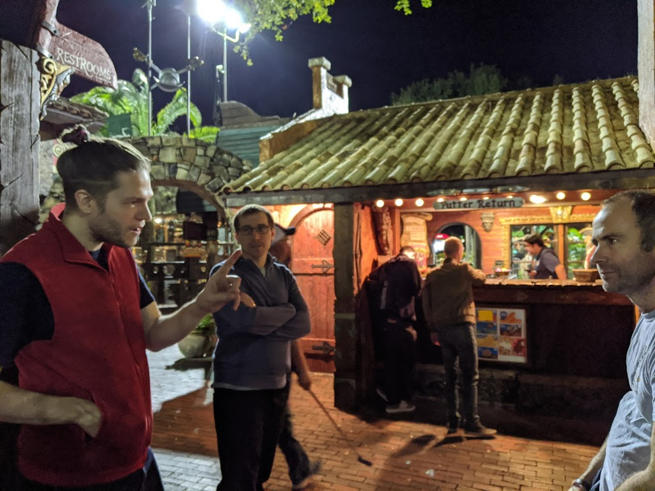
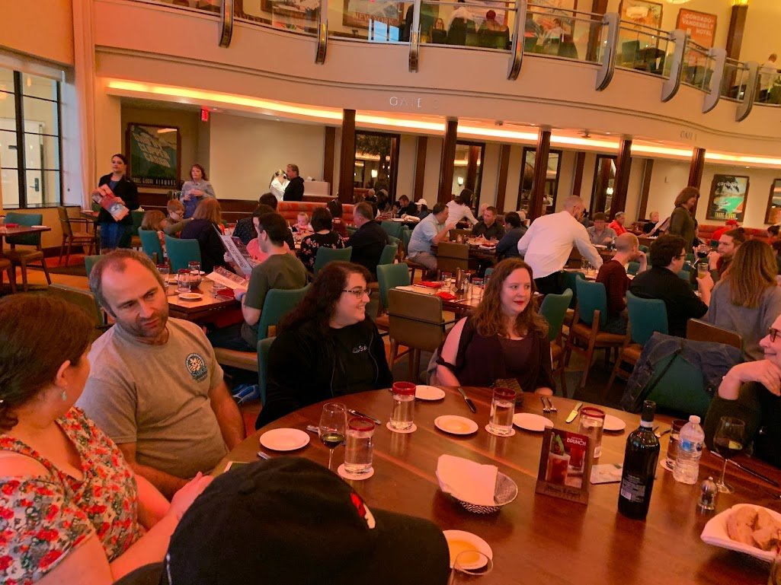
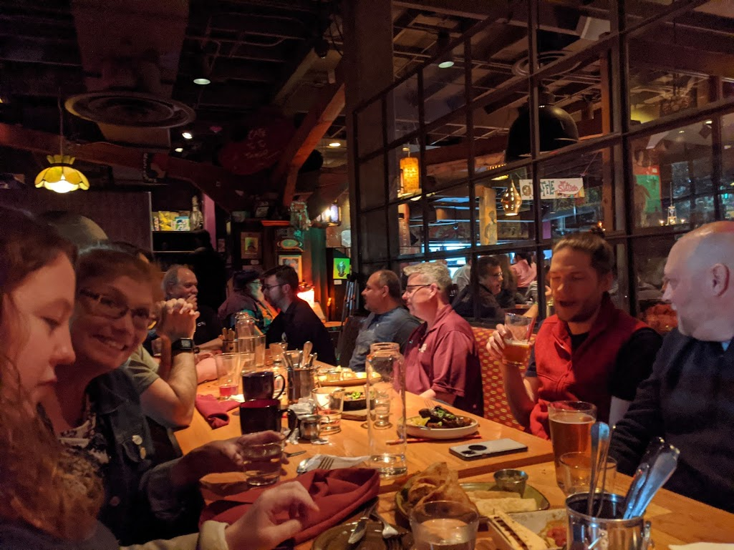

Advantage: Open Community
Like any retreat, team building is important

Slide 9
Advantage: Open Community
We have a annual team retreat – "Sakai Camp" – and you are invited and encouraged to contribute.
You are in the same room as the core leadership for every aspect of Sakai

Slide 10

Advantage: Hosting Options
Vendor Cloud
Local Hosting
Enterprise On Site**
Vendor upgrade
Vendor performance monitoring
Regular meetings with your vendor
You can commission feature requests
Physical Hardware
Linux
Docker Images
Locally Owned
Digital Ocean
Amazon – AMIs
Quarterly releases
Physical or Locally Owned Cloud Hardware
Vendor does upgrades
Vendor does tuning / monitoring
Local hosting + Support
Because we all share one version of Sakai you can move between these choices with no data lost, conversion or outage.

Slide 11



Summary
When you adopt Sakai you become an important part of our community. You have a range of hosting choices with the option to move between hosting options with no data loss and barely an outage. With local and enterprise on premises hosting you can maintain 100% control over your learners learning data.

Slide 12

But there is more...

Slide 13


Slide 14



Cloud LMS Conundrum...
Campus IT
Most Faculty
A Few Faculty
Simplicity (for IT)
Stability
Scalability
Upload PowerPoint
Have a Gradebook
Have a Due Dates
Don't move my cheese
I have an idea...
Is there a feature for...?
Can I talk to an expert on the LMS?

Slide 15
Sakai Plus
Gives you the option to seamlessly provide two learning management systems to your teachers and learners with no additional technical effort.
Sakai can be plugged into any LMS that supports LTI Advantage(tm) and Sakai will place all grades in the Enterprise LMS.

Slide 16


Campus
Information
System
Enterprise
Wide LMS
LTI Advantage
Synchronized grades
Synchronized calendar
Course import/export

Slide 17
For the Win-Win
Campus IT
Most Faculty
A Few Faculty
Simplicity (for IT)
Stability
Scalability
Upload PowerPoint
Have a Gradebook
Have Due Dates
Don't move my cheese
I have an idea...
Is there a feature for?
Can I talk to an expert on the LMS?

Slide 18
Hosting Options
Vendor Cloud
Local Hosting
Enterprise On Site**
Vendor upgrade
Vendor performance monitoring
Regular meetings with your vendor
You can commission feature requests
Physical Hardware
Linux
Docker Images
Locally Owned
Digital Ocean
Amazon – AMIs
Quarterly releases
Physical or Locally Owned Cloud Hardware
Vendor does upgrades
Vendor does tuning / monitoring
Local hosting + Support
Because we all share one version of Sakai you can move between these choices with no data lost, conversion or outage.

Slide 19
Summary
With Sakai you are part of a community. Sakai has the widest range of hosting options, best-in-class standards and integration and unique transition and co-existence options. Sakai helps you grow to meet the needs of all of your campus teachers and learners.
Sakai is the best LMS for Learning.

Slide 20
Facetious !!
This is a comedy routine exploring a possible future. It is not a Sakai Roadmap – or promise in any form.
It is comedy folks – that is why the presenter is wearing a costume.

Slide 21
THANK YOU
Charles R. Severance
drchuck@learnxp.com www.learnxp.com

